Slide 1
AI-Driven Customer Intelligence System for Strategic Business Decision Making Using Unsupervised Learning
Chandramouli Gangopadhyay

Slide 2
Problem Statement
• Businesses lack labeled customer data
• Hard to identify valuable customers
• Need data-driven segmentation
Goal:
→ Discover hidden customer groups
→ Improve marketing & retention
Dataset Description:
The dataset contains customer transaction data including Invoice details, Quantity, Unit Price, Customer ID, and Country. It is used to analyze customer purchasing behavior and perform segmentation.

Slide 3
Why Unsupervised Learning?
• No labeled dataset available
• Helps discover hidden patterns
• Groups customers automatically
Best suited for real-world business data

Slide 4
System Pipeline
Raw Data
↓
Data Cleaning
↓
Feature Engineering (RFM + Ratios)
↓
Clustering Algorithms
↓
Evaluation Metrics
↓
Cluster Interpretation
↓
Business Insights

Slide 5
Feature Engineering (RFM)
RFM Features: • Recency • Frequency • Monetary Derived Ratios: • Avg Order Value • Purchase Rate → Captures deeper customer behavior

Slide 6
Algorithms Used
K-Means
DBSCAN
Hierarchical Clustering
Gaussian Mixture Model
Comparison based on: • Silhouette Score • Davies-Bouldin Index

Slide 7
Best Model
Best Algorithm: K-Means
Reason:
• Better cluster separation
• Higher Silhouette Score
• Lower Davies-Bouldin Index

Slide 8
Clustering Results
• Optimal clusters: 4
• Segments identified:
High Value, Loyal, At Risk, Low Value
K=4 chosen because:
• Elbow curve shows diminishing returns after 4
• Silhouette score is highest at k=4
• Clusters are well-separated in PCA visualization

Slide 9
Clustering Interpretetion
Cluster Examples:
• High-value premium buyers
• Budget occasional shoppers
• High-frequency low spenders
• At-risk customers
→ Based on RFM behavior

Slide 10
Business Insights
• High Revenue → Focus retention
• Premium Users → Upsell products
• At-risk → Re-engagement campaigns
• Low-value → Discount strategies

Slide 11
Real-World Impact
• Targeted marketing campaigns
• Improved customer retention
• Better decision-making
• Increased revenue
→ Acts as a Customer Intelligence System

Slide 12
Advanced Features
Advanced Features Implemented:
• Customer Lifetime Value (CLV) grouping
→ Identifies long-term valuable customers
• Time-based Segmentation
→ Tracks customer activity over time
→ Enhances business decision-making
Both of these Enhance long-term customer understanding and strategic decision-making

Slide 13
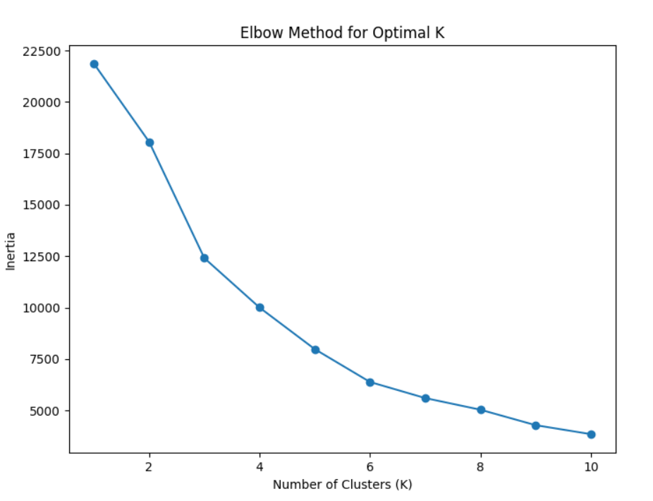
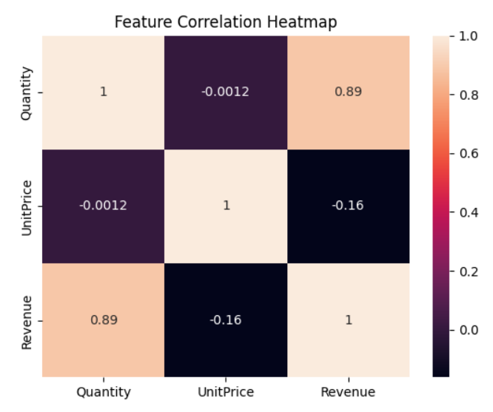
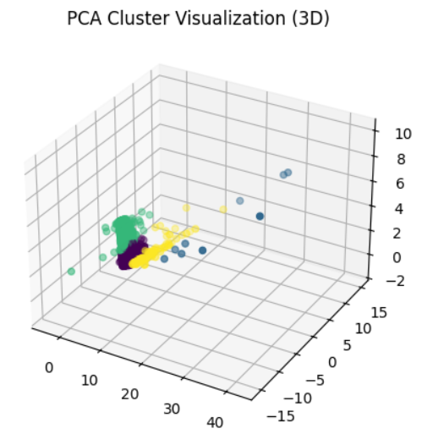
Visualization
Elbow Method
Heat-Map

Slide 14
Conclusion
Clustering helps businesses understand customers
and take data-driven decisions
Thank You

